Slide 1
Working with data studio

Slide 2
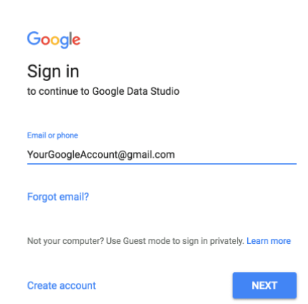
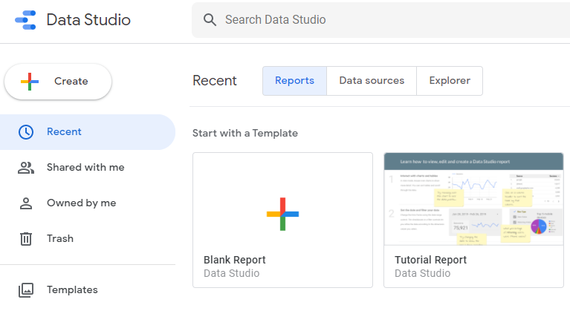
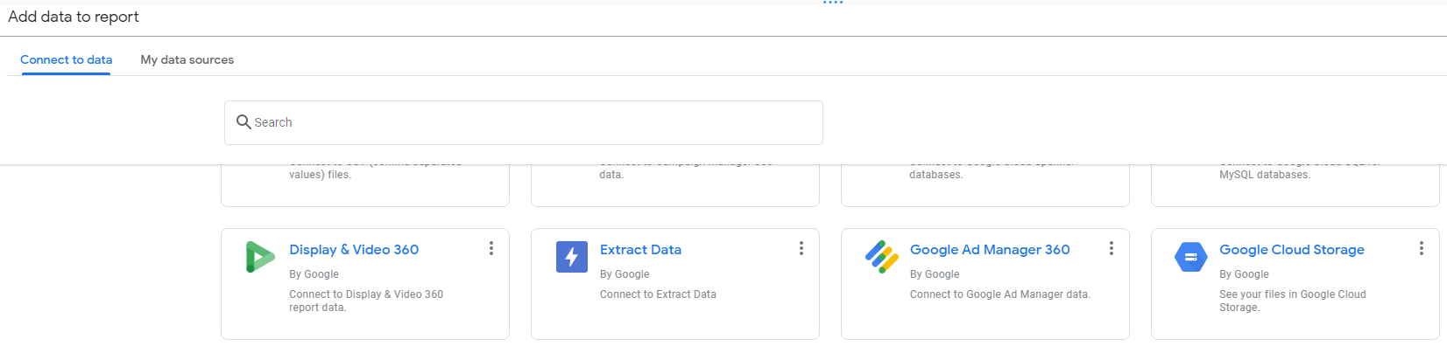
Working with Data Studio (1/3)
1
SIGN IN
2
CREATE BLANK REPORT
3
ADD DATA SOURCE
Visit datastudio.google.com and sign in with google account
Once signed in, simply click on “+” for the “Blank” report template. There are other pre-built templates you can use
After creating a blank report, a add data to report pop up will appear
Next, find the Google Cloud Storage and select it. There are many other connectors to choose from

Slide 3
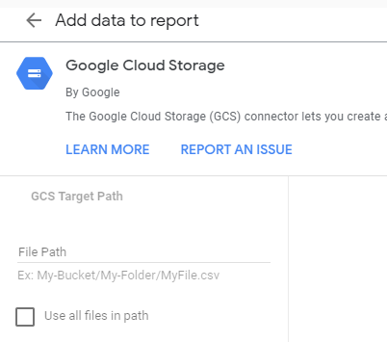
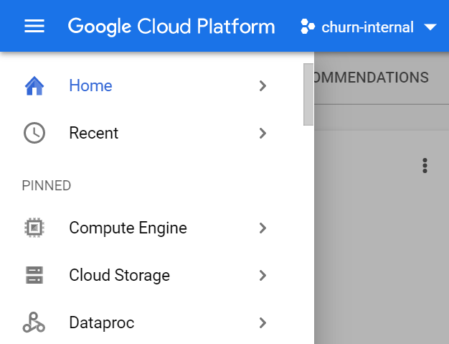
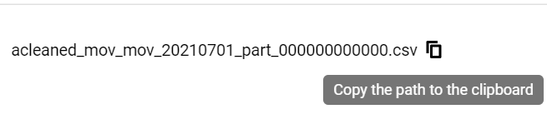
Working with Data Studio (2/3)
4
COPY FILE PATH
5
GCP
6
GCP
Navigate to Google Cloud Storage and copy the path of the dataset to be used in the EDA dashboard
Click Cloud Storage and navigate to the desired dataset
Copy the file path to the clipboard and navigate back to Data Studio

Slide 4
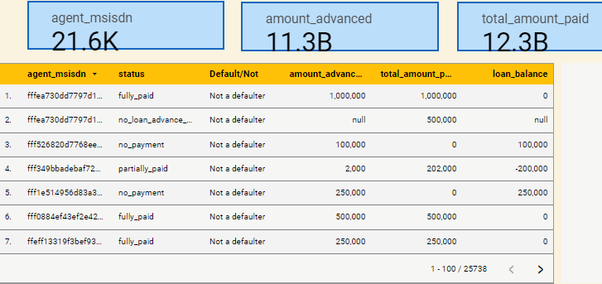
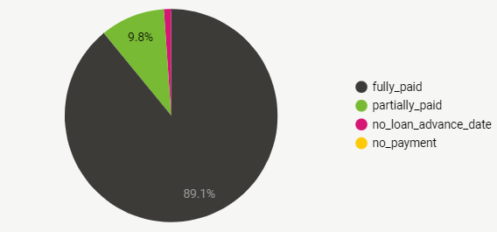
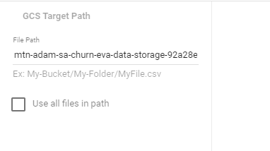
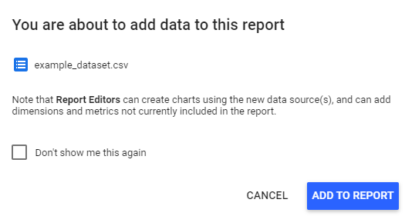
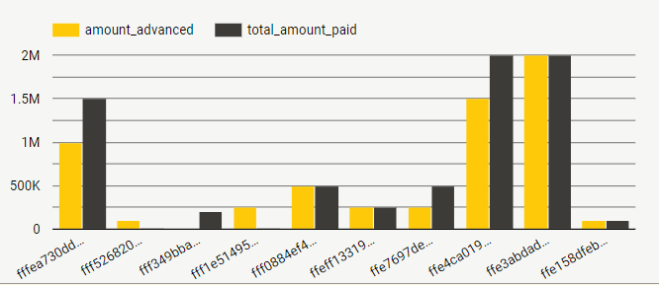
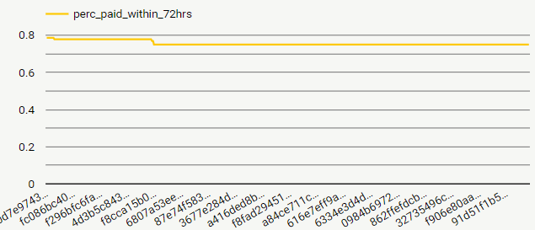
MTN ADAM – DATA DISCOVERY & REMEDIATION
Working with Data Studio (3/3)
7
PASTE FILE PATH
8
ADD DATA TO REPORT
9
BUILD EDA DASHBOARD
Paste the copied file path and
click add
The below pop up will appear,
then click add to report
Cancel
Add
Identify variables and data types
Analyse basic metrics
Perform graphical analysis
Transform variables
Spot outliers

